Slide 1

GUYUS REAL ESTATE
PRESENTED BY: MATTHIAS ONIDOMA

Slide 2

INTRODUCTION
Guyus Real Estate is a renowned real estate company with a
sprawling portfolio that spans residential, commercial and land
sales across multiple locations. Despite its success in the Real
Estate market, Guyus Real Estate faces significant challenges in
Its reporting and analytical processes.
The Organization relies on Excel to compile, analyze and report
Its monthly sales and transaction data. This method has become
Increasingly cumbersome and time consuming.
Team Alpha was contracted to analyze the company’s
data using Power BI, to reduce delays in decision making, reduce errors and inconsistencies and come up with a detailed Report (as can be seen in the slides below).

Slide 3
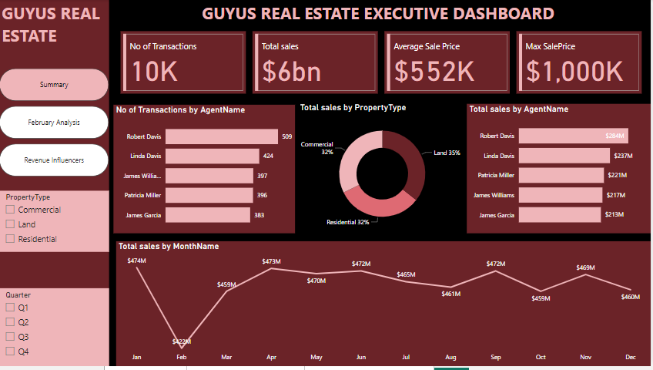
INSIGHTS

Slide 4
KPIs
Number of Transaction
10,000
Total Revenue(Sales)
6 Billion Dollars
Average Sale Price
$552,000

Slide 5
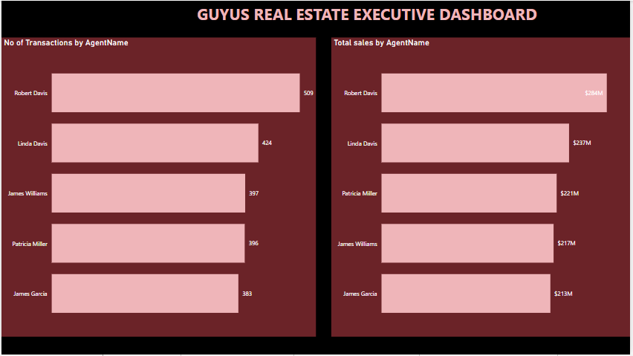
TOP 5 AGENTS

Slide 6
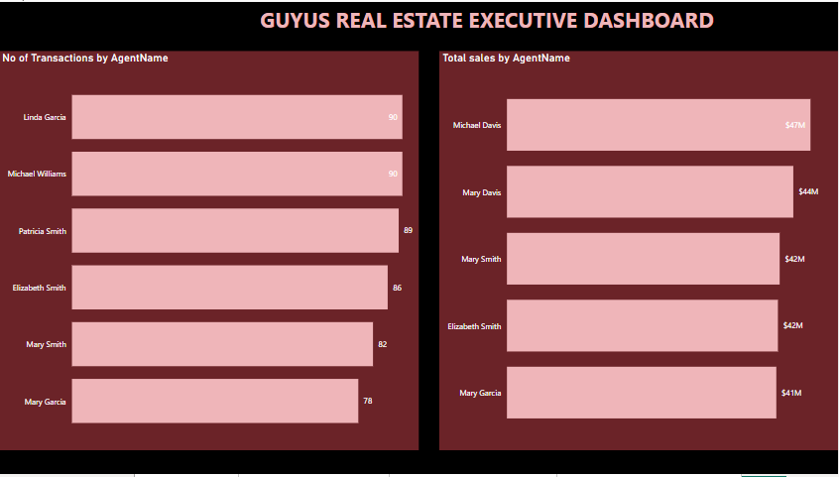
BOTTOM 5 AGENTS

Slide 7
Total Sales by Property Type
Commercial:
Total Sales Number of Transaction
$354M (32%) 658
Residential:
Total Sales Number of Transaction $398M (32%) 698
Land :
Total Sales Number of Transaction $419M (35%) 755

Slide 8
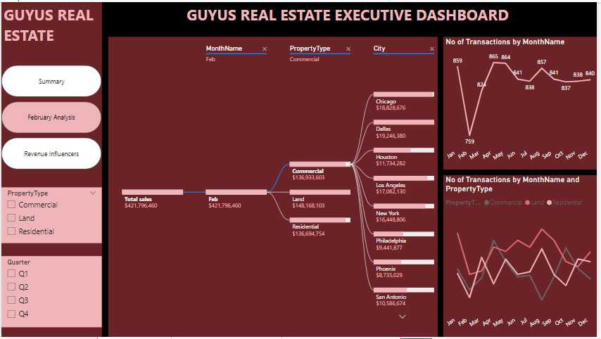
FEBRUARY ANALYSIS

Slide 9
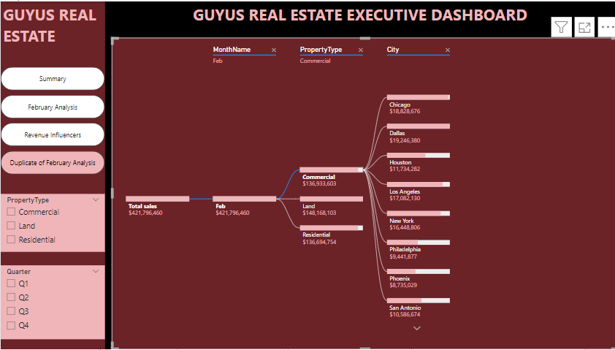
FEBRUARY ANALYSIS

Slide 10
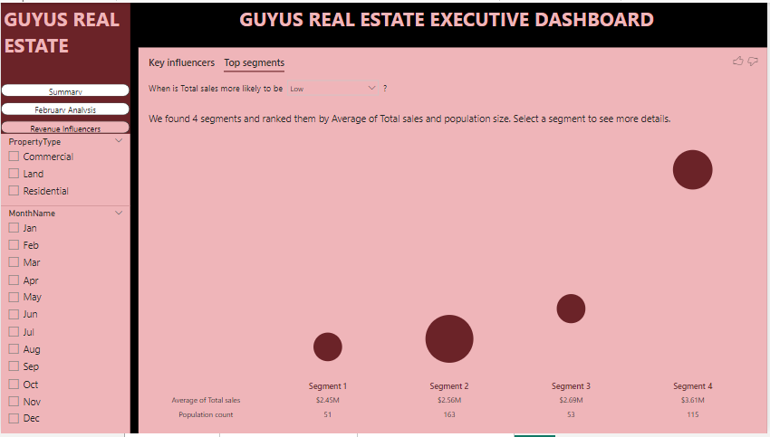
TOP SEGMENTS

Slide 11
RECOMMENDATIONS
The Management should use States like Texas and California that generated very high revenue as reference point and replicate their business strategy in low revenue States like Arizona and Pennysylvania.
Furthermore, more branches should be created within Texas and California to further boost revenue.
A thorough investigation should be carried out to the determine the cause of the drop in revenue in the month of February across the three property type.

